Slide 1
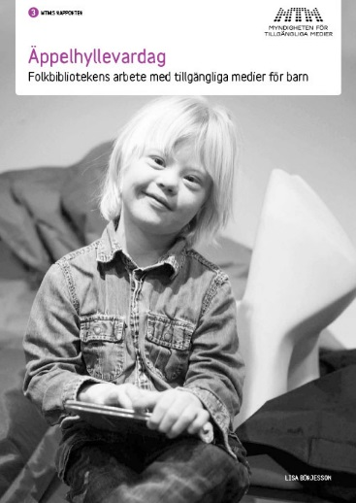
Everyday Life of the Apple Shelf
Public Libraries’ Work With
Accessible Media for Children
Bitte Kronkvist
Swedish Agency for Accessible Media, MTM
IFLA, Lyon, August 18th, 2014

Slide 2
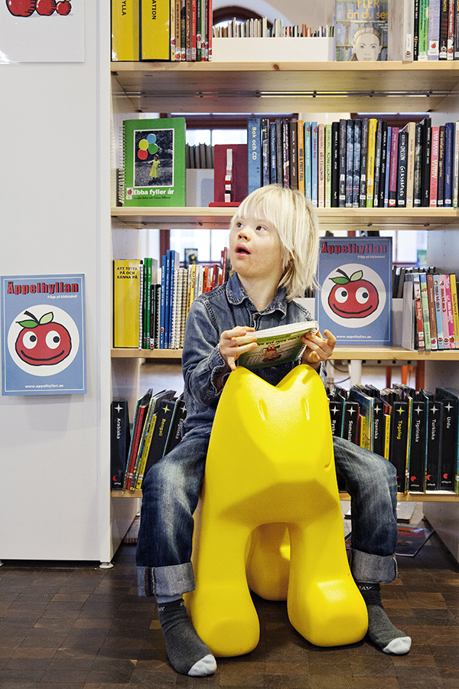
Apple shelf
the libraries responsibility and mission towards children with print disabilities
a dedicated shelf in the library's children's section
the shelfs contain
various formats of accessible media
information about disabilities and language development
target group
persons with print disabilities,
parents, teachers, students
support to libraries in their work with
accessible media,
language development and reading promotion for children with print disabilities

Slide 3
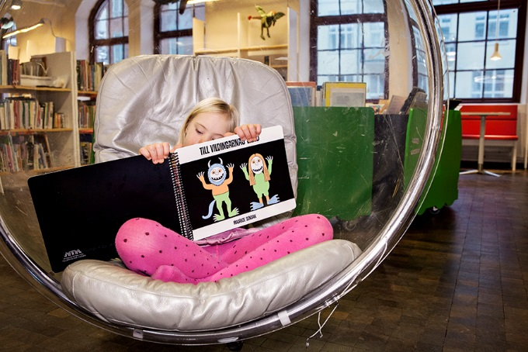
Survey questions
How does the libraries run the Apple shelves in their everyday work?
What role does the Apple shelves have for information and distribution about accessible media?
What success factors are connected to the work with Apple Shelfs?
What support do libraries need for working with Apple Shelfs?

Slide 4
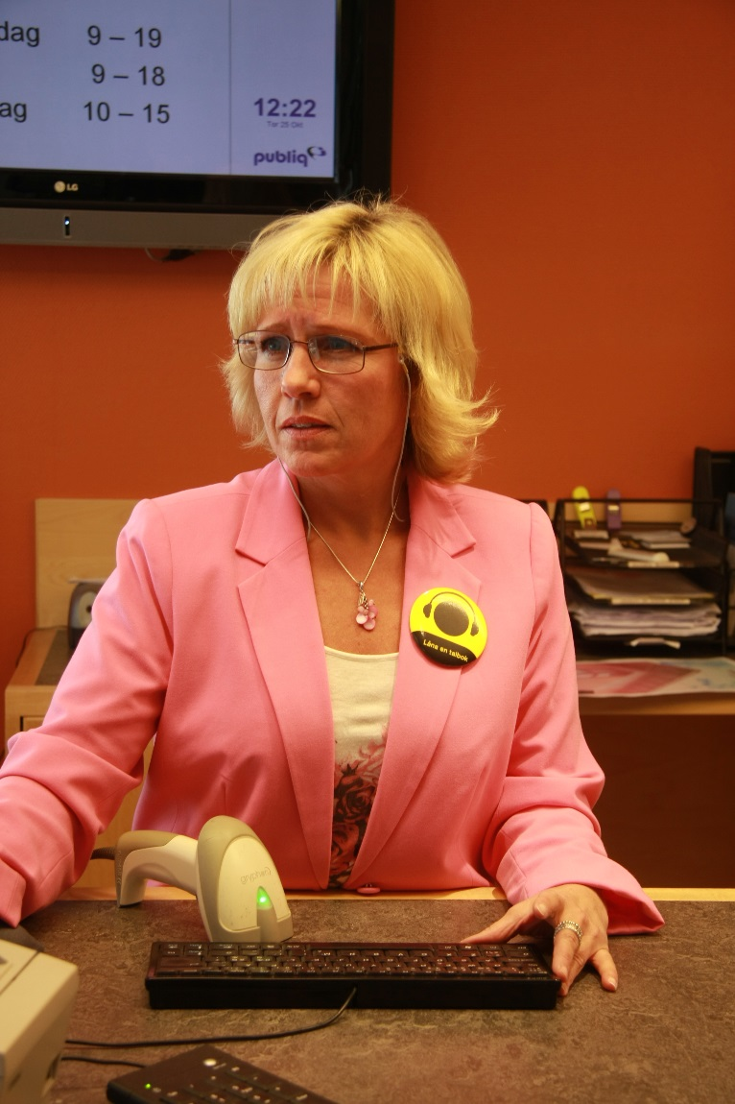
Survey
Qualitative survey
interviews
dialogue with staff members
6 libraries in four different regions
40-120 minutes per interview
Observations of the Apple shelf and the surroundings
Cooperation between MTM, regional libraries and the University of Uppsala

Slide 5
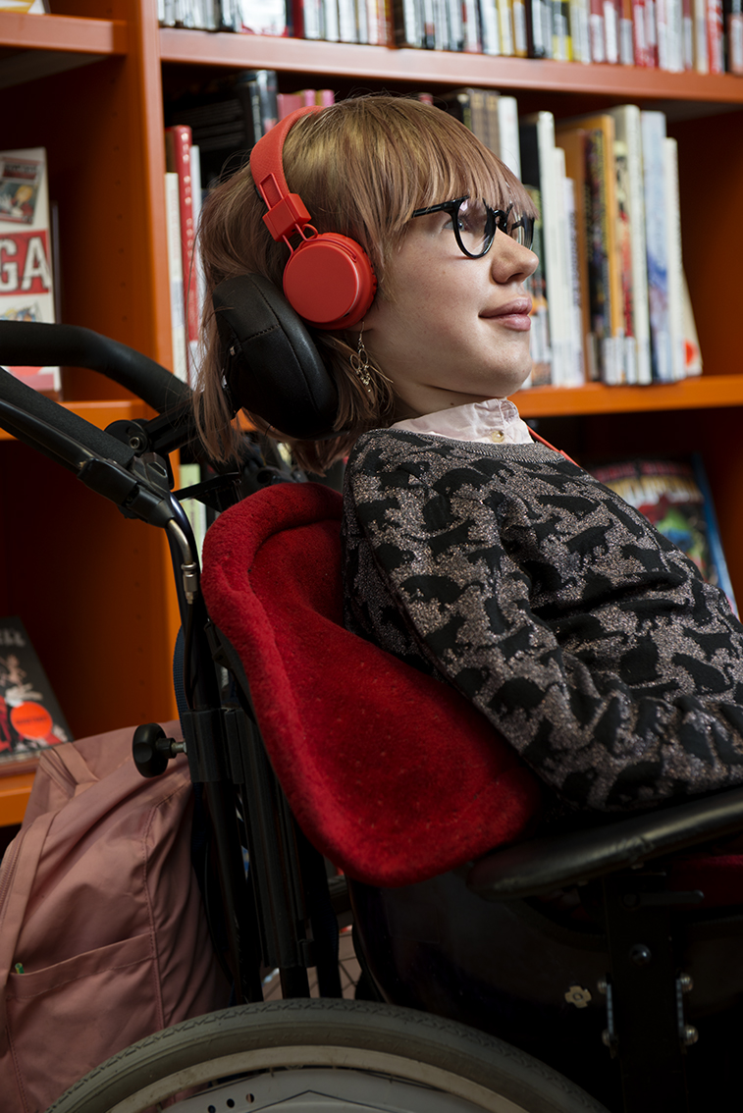
Analysis
the Apple shelf: planning, responsibility and follow-up
the Apple shelf in the library room
everyday life of the Apple shelf
information about accessible media
distribution of accessible media

Slide 6
What to do?
Library staff
shared responsibility
strategic planning
define target groups
the Apple Shelf is a working method and in constant development
information about the library's mission and the Apple Shelf
Management
reflect on the role of the Apple Shelf
define responsibilities and knowledge requirements for the Apple Shelf

Slide 7
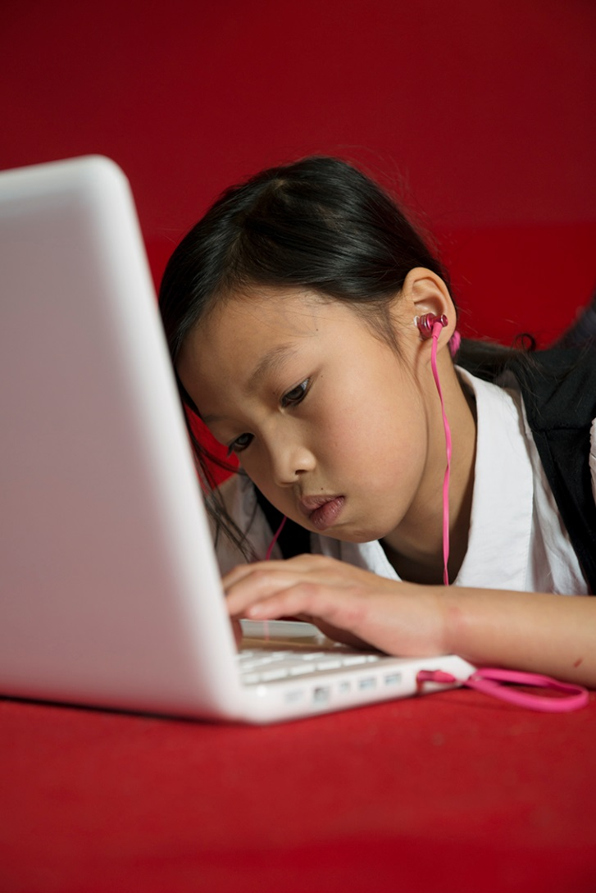
What to do?
Regional level
support for training and planning, implementation and follow up
initiate and implement development
National level
identify and develop services

Slide 8
Thanks!
Bitte Kronkvist
Swedish Agency for Accessible Media
bitte.kronkvist@mtm.se

