Slide 1
INTERNATIONAL ADVOCACY PROGRAMME
LIBRARIES, DEVELOPMENT, AND THE UN 2030 AGENDA
TOPIC 1B: IFLA’S WORK AT THE UN

Slide 2
For trainers
If you edit this file, please change the file name to show the region and the new date
Delete the word [Master] from the file name
Insert the region, eg Asia, Africa, Europe, LAC
Change the date, using format YYYYMMDD
Use underscore [ _ ] to link the elements of the file name
IFLA_IAP_Topic1B_IFLA_UN_Goal_16-10_[Region]_YYYYMMDD

Slide 3
Overview
In Topic 1B, you are introduced to IFLA’s engagement with the UN to introduce Goal 16.10
Option 1
A link is provided to the video of a webinar, where Stuart Hamilton explains the journey eForum Webinar: Libraries, The Lyon Declaration and the Road to 2030 https://www.youtube.com/watch?v=SXxR4T6_3KM [24’51”]
Option 2
The presentation includes the slides from the webinar for situations where it is not possible to watch the video

Slide 4
https://www.youtube.com/watch?v=SXxR4T6_3KM [24’51”]

Slide 5
If the recording is not available…
Stuart Hamilton, Deputy Director of IFLA, explains the journey IFLA took to see Target 16.10 included in the SDGs
The effort and persistence that was required to achieve this at the UN in New York
Arguing that access to information is fundamental to better decision making, and beyond that, to ensure people have a better life

Slide 6
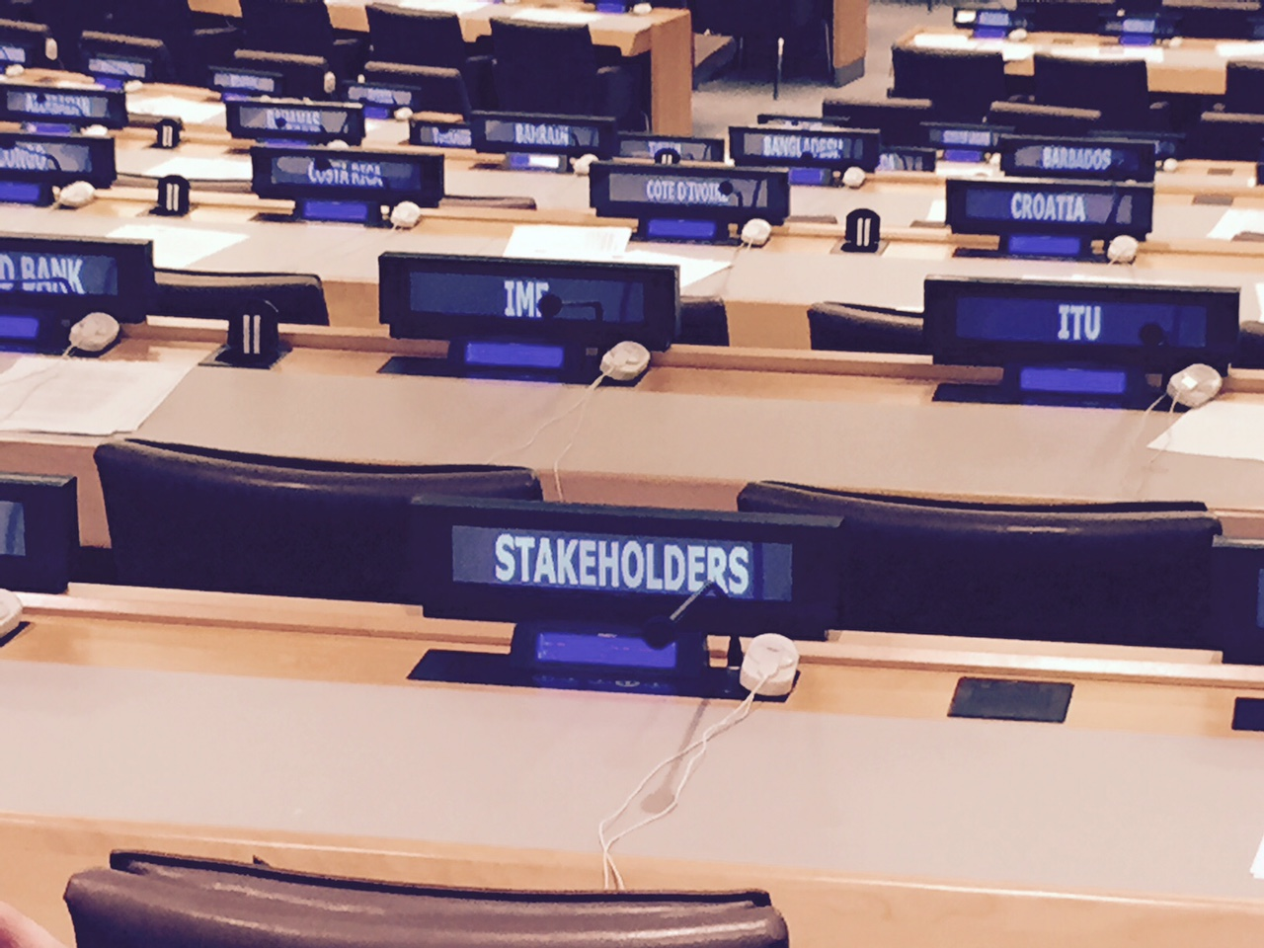
Libraries, The Lyon Declaration
and the Road to 2030
Stuart Hamilton,
IFLA Deputy Secretary General
Notes:
Going to recap the journey
Break down what happened
Talk about the role of the Lyon Declaration in helping us achieve success

Slide 7
Roadmap to Post-2015
Rio+20 UN Conference on Sustainable Development (2012)
Outcome: ‘The Future We Want’ (June)
UN Secretary General’s High Level Panel (2013)
Outcome: Report inc. ‘The Data Revolution’ (May)
Open Working Group on Sustainable Development Goals (2014)
Outcome: Draft SDGs (September)
UN General Assembly (2014)
Outcome: Secretary General’s Synthesis Report (December)
Inter-Governmental Negotiations (2015)
Outcome: Zero Draft Post-2015 Framework Document (June)
Post-2015 Development Summit (2015)
Outcome: Post-2015 Development Framework: Declaration, SDGs, Means of Implementation, Monitoring and Accountability (September)
Notes:
Talk about how we got progressively engaged
Talk about the HUGE number of different players in the development field
Mention the UN General Assembly 2013, and the realisation that no one was representing our point of view
Talk about how by the end of that General Assembly week we had some new friends, and a plan

Slide 8
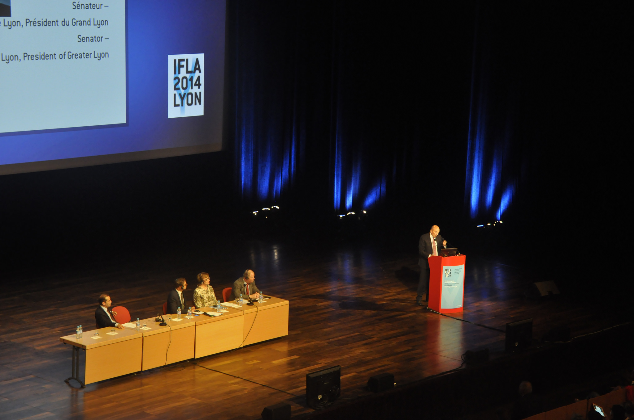
Launch of the Lyon Declaration on Access to Information and Development,
Lyon WLIC, August 2014
Notes:
What is a Declaration?
Talk about how we developed it, building on endorsed policy and positions from IFLA’s past and present
Talk about the context that it needed to be introduced into – ongoing negotiations where everyone wants something – and the target audience – ALL Member States, not just developing countries
Talk about how we had a rough idea of what broad goals and targets there were going to be and, sadly, there wasn’t going to be one on building 100 new libraries in every country
Talk about it therefore needed for it to be bigger than the library community – and NOT about libraries per se. About Access to Information, and then when people got interested in that, we could bring libraries in
Talk about how we launched it, at Lyon, with big names already on board

Slide 9
What does the Lyon Declaration ask for?
6. We call on Member States of the United Nations to acknowledge that access to information, and the skills to use it effectively, are required for sustainable development, and ensure that this is recognised in the post-2015 development agenda by:
Acknowledging the public's right to access information and data, while respecting the right to individual privacy.
Recognising the important role of local authorities, information intermediaries and infrastructure such as ICTs and an open Internet as a means of implementation.
Adopting policy, standards and legislation to ensure the continued funding, integrity, preservation and provision of information by governments, and access by people.
Developing targets and indicators that enable measurement of the impact of access to information and data and reporting on progress during each year of the goals in a Development and Access to Information (DA2I) report.
Notes:
Talk about how the Declaration had to have a point, an ask
Walk through the ask, including the text before a) – d)
Re-iterate that this is aimed at Member States – and that all libraries live in a Member State, and can therefore influence them

Slide 10
After Lyon
Section Contributions
http://www.ifla.org/node/7408
UN DPI Conference (August 2014)
http://www.ifla.org/node/8776
Social media and communications
@IFLA_ALP
http://www.ifla.org/libraries-development
Notes:
Talk about sourcing contributions from the sections, and name sections who contributed – say it’s not too late
Talk about the Declaration’s first visit to the UN – more signatories
Talk about moving IFLA’s comms into place, and the development webpages

Slide 11
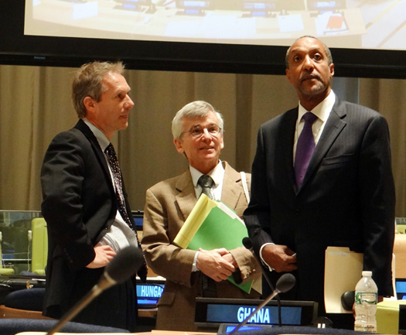
Open Working Group Co-Chairs: Ambassadors Csaba (left, Hungary)
and Kamau (right, Kenya)
Notes:
Open Working Group (March – July 2014) – the outcomes would be key to what we could hope to achieve with the Declaration
Explain make-up of OWG – a group of 70 nominated UN Member States who were charged with proposing a set of global goals for consideration by the UN by the end of 2014
Explain how at OWG meetings we would engage with delegates, handout flyers, put on side-events, cajole and persuade that A2I should be include
Talk about the controversy of A2I, how some member states didn’t want a focus on good governance, transparency, accountability

Slide 12
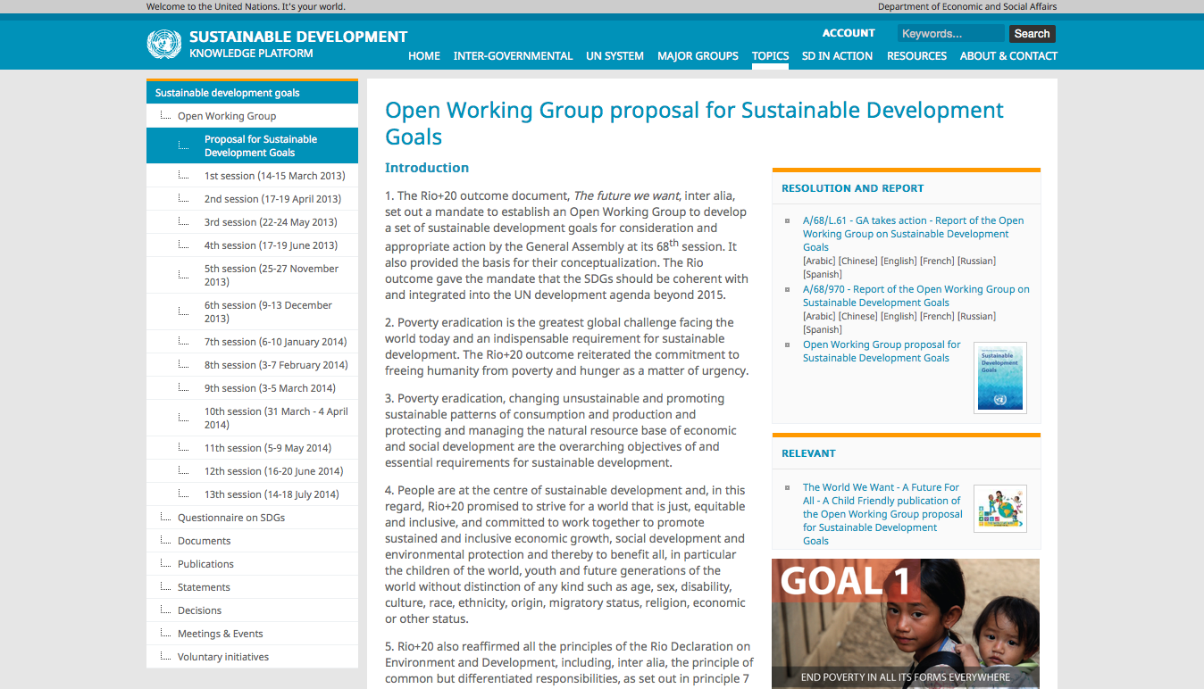
September 2014
www.sustainabledevelopment.org
Notes:
September – we got the draft proposal for the SDGs
17 Goals, 169 targets – remember there were only 8 MDGs

Slide 13
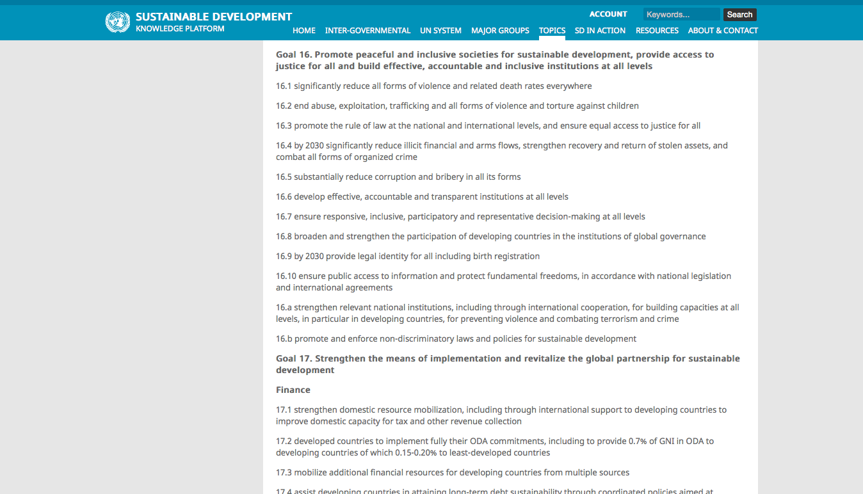
Notes:
And here it was – 16.10. The first place we scrolled to
First battle was won – it was in the text
But could it stay there? Still a year of negotiations to go

Slide 14
http://www.ifla.org/publications/toolkit--libraries-and-the-un-post-2015-development-agenda
Notes:
So, in October, once we had something to work with, we went back to signatories and the IFLA network
Talk about the toolkit, what it had in it, what we wanted people to do etc.
Downloaded 1000 times
Outreach – developing partners in transparency sector – World Bank webinar on A2I in October
Talk about how we were now waiting for December, but trying to get library reps to take meetings
In December we got the Secretary General’s Synthesis report - what else in play? HLP, discussions on financing
“The Road to Dignity by 2030: Ending Poverty, Transforming All Lives and Protecting the Planet” - 6 elements for delivering
What’s it say about A2I?
Explain what came next – the Intergovernmental Negotiations (IGN) Process (Jan – August 2015)
IFLA team – Donna Scheeder, Loida Garcia-Febo and Gerald Leitner (ALP) all contributed
Lyon Declaration at the UN (Feb, April)
Joining the TAP Network, sitting on the Steering Committee
Talk about what this work looks like when you’re in the building

Slide 15
Notes:
So overall, you could say we had a two handed strategy – engage in New York, get our members and Lyon Declaration signatories engaged in capitals
Revised Toolkit (February 2015)
National Development Plans (June 2015)
In capital work – getting meetings with Ministers, and policymakers. Talk about who took meetings, and what they found difficult

Slide 16
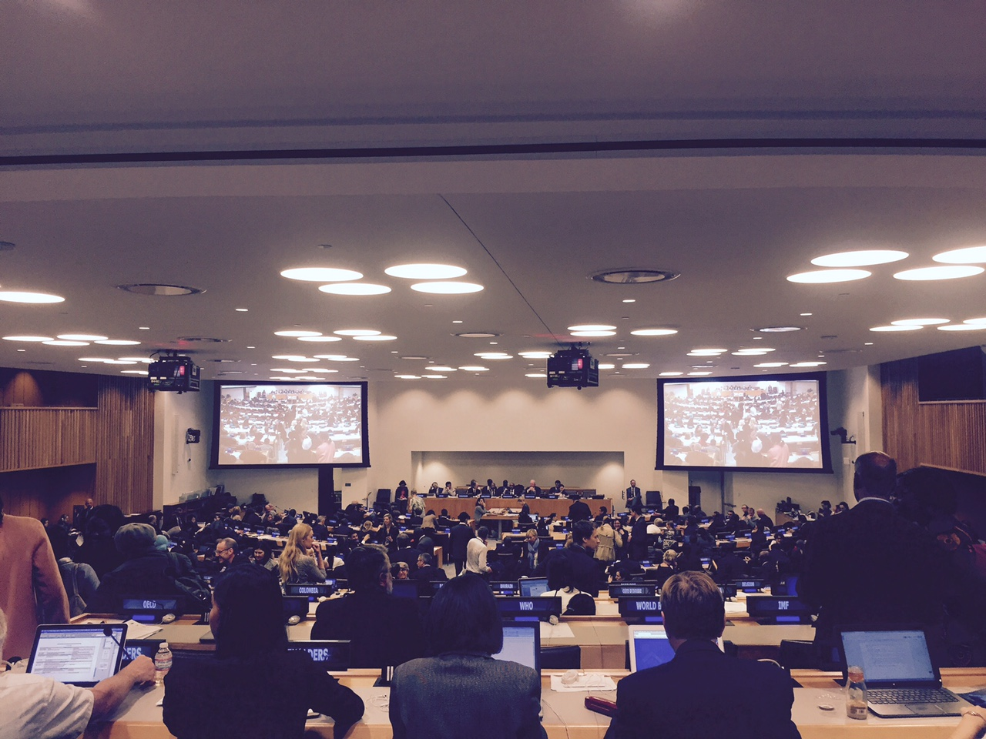
Notes:
Endgame. It was becoming increasingly certain that the Goals and Targets produced by the Open Working Group would not be re-opened
Up for grabs: the Declaration, the Means of Implementation (the text on how we will do it) and the text on monitoring and review (or how we will measure success)
Talk about the meetings in this room
Talk about the Zero Draft, the revised zero draft

